Slide 1

Demographic Correlations in Consumer Behavior Case Study: Yelp API Data Ken, Sarah, Alan, Monali

Slide 2
Overview
Yelp API & Census Data
Data Analysis & Trends
Ethnicity
Age
Income

Slide 3
Purpose
Why Yelp?
Nationwide
Available API
Robust
Mainstream
Consumer Behavior

Slide 4
Methods
Which data?
Yelp Data API
Census Data API
Data Analysis (Available Metrics)
Pandas for Data Processing
Seaborn and Matplotlib for Data Visualization

Slide 5
Metrics
Yelp Metrics
Review Ratings
Review Quantity
Demographics
Age
Ethnicity
Income
Population

Slide 6
Are reviews an accurate representation?
Ratings
Do consumers skew towards ratings that are more favorable or unfavorable?
Demographics:
Do socio-economic factors of an area affect the local business ratings and reviews?

Slide 7
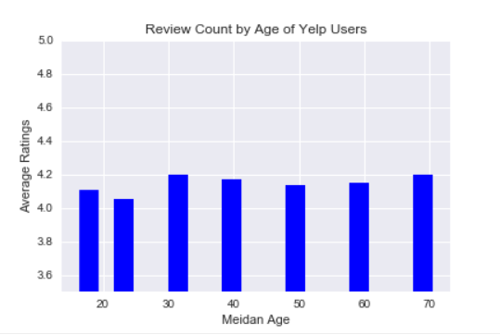
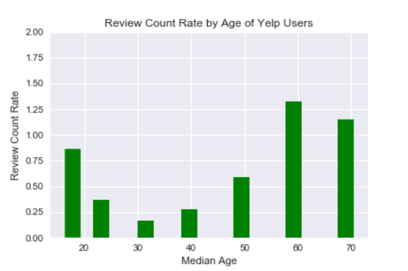
Review Count by Age

Slide 8
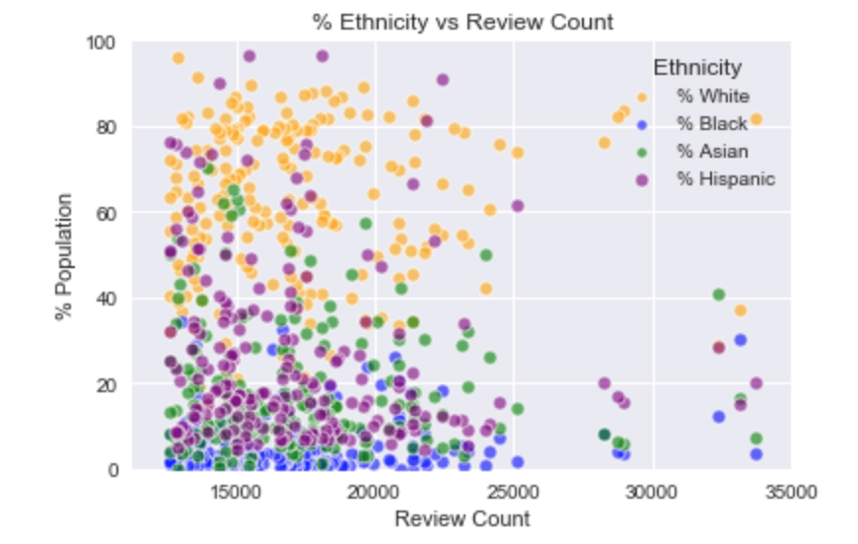
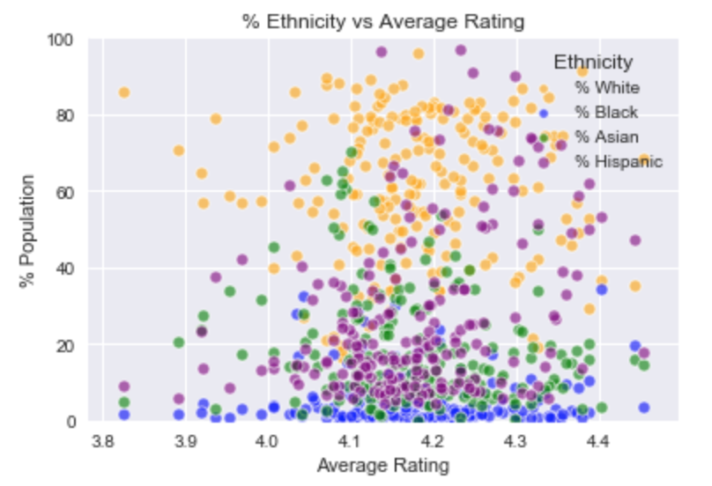
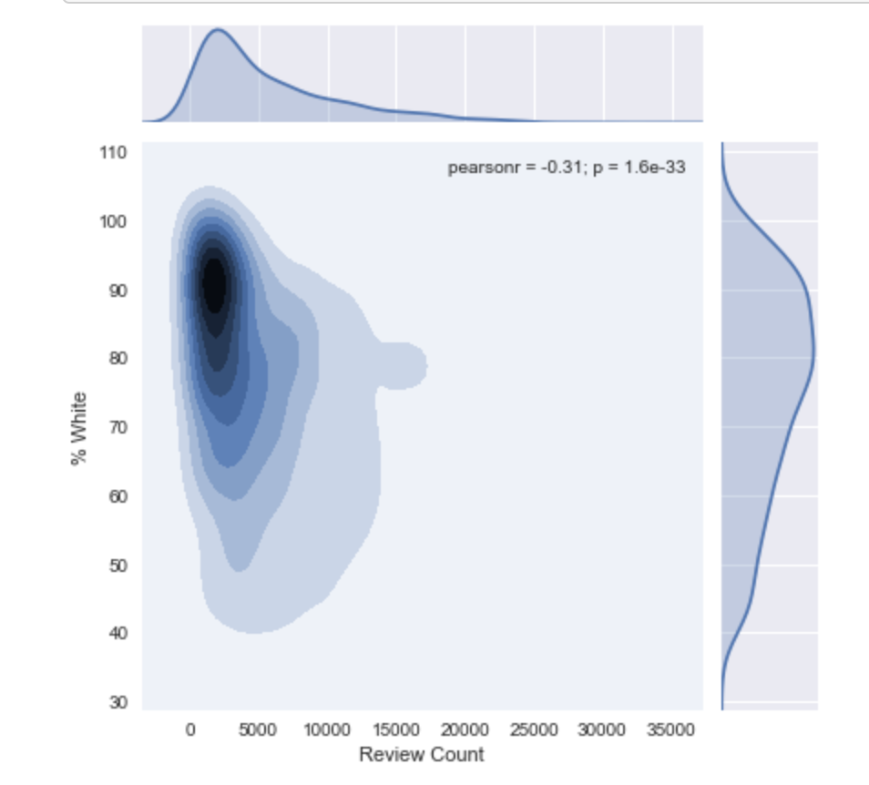
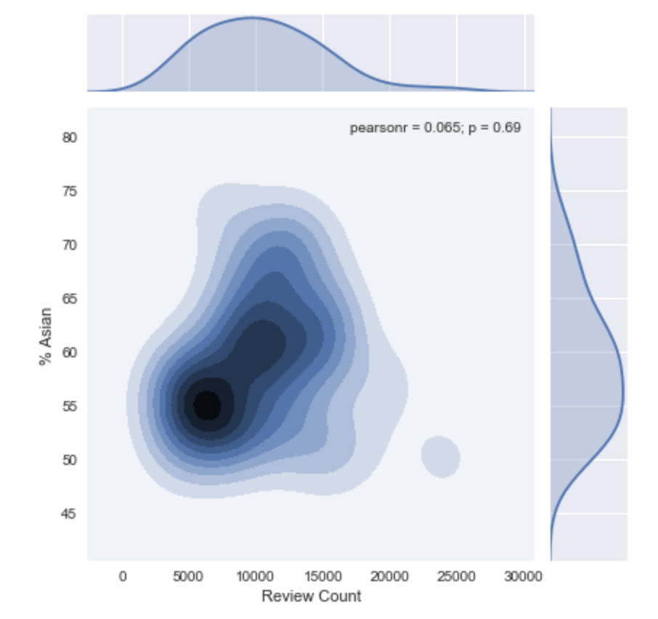
Ethnicity vs. Review Count

Slide 9
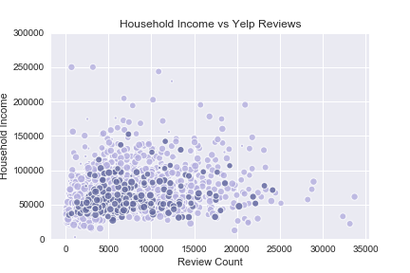
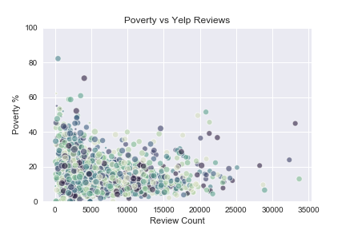
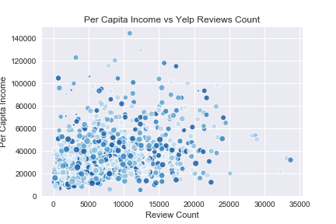
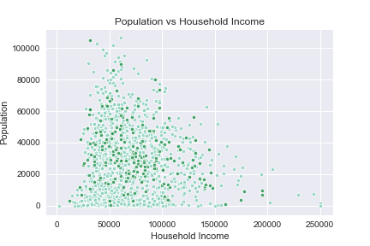
Income

Slide 10
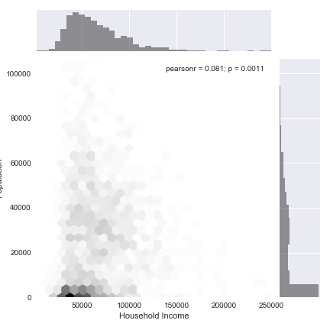
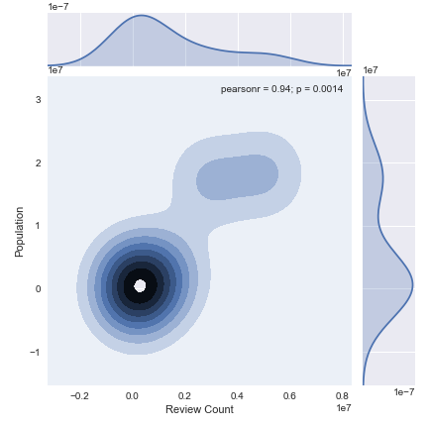
Population

Slide 11
Conclusion
Ratings
Do consumers skew towards ratings that are more favorable or unfavorable?
Users were more likely to provide above average reviews that were favorable.
Demographics:
Do socio-economic factors of an area affect the local business ratings and reviews?
Businesses in affluent zip codes were more likely to receive favorable reviews.
Conclusion
Yelp ratings were more consistent than expected and represent the typical user experience rather than being skewed by extremes.

Slide 12
Limitations
Price
We were unable to segment by price (ie. Burger King vs. Steak House)
Data Set
Yelp data and Census data are not necessarily aligned
Yelp data has a selection bias (user-generated vs. random sample)

Slide 13
Further Research
Genre
Segmenting ethnicity data by genre of cuisine.
Cultures
Looking at other languages or countries.
Device
Comparing the app vs. website version.
Franchise
Comparing data trends for franchise vs. independent.

Slide 14
Thank you

